Slide 1
Analysis of single-cell ATAC-seq data
Orr Ashenberg, Jacques Serizay, Fabrício Almeida-Silva
November, 2024
Notes:
₁

Slide 2
Multimodal measurements
Protein
abundance
Spatial
transcriptomics
Genome
Chromatin accessibility
Gene expression
Immune repertoire
Combining single-cell transcriptomic measurements with other data modalities can reveal gene function and gene regulation.
Efremova M. et al. (2020) Nature Methods. 17:11-20.
Notes:
In addition to RNA, we can profile many other cellular molecules. DNA- genome, epigenome- chromatin accessibility, methylation. Protein- mass cytometry. One particularly important advance is being able to make multiple different measurements on a single cell. Establish causality between RNA + protein or epigenome + RNA.

Slide 3
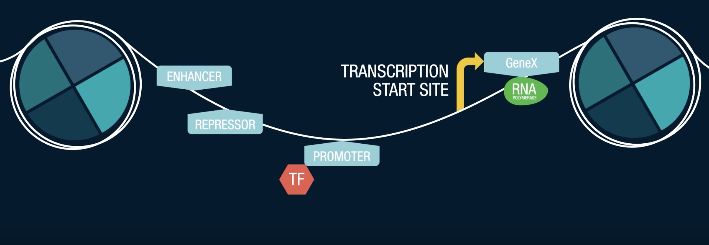
ATAC-Seq detects accessible chromatin regions
In the cell nucleus, the chromosomes contain tightly packed chromatin material. Part of the chromatin is open and accessible to many regulatory factors who control the expression and suppression of a variety of genes.
“How Single-Cell ATAC-Seq Works”, Bio-Rad Laboratories
Notes:
In the cell nucleus, the chromosomes contain tightly packed chromatin material. Part of the chromatin is open and accessible to many regulatory factors who control the expression and suppression of a variety of genes.
The DNA is wrapped around chromatin. To know what has the potential to be expressed we can measure the open chromatone.

Slide 4
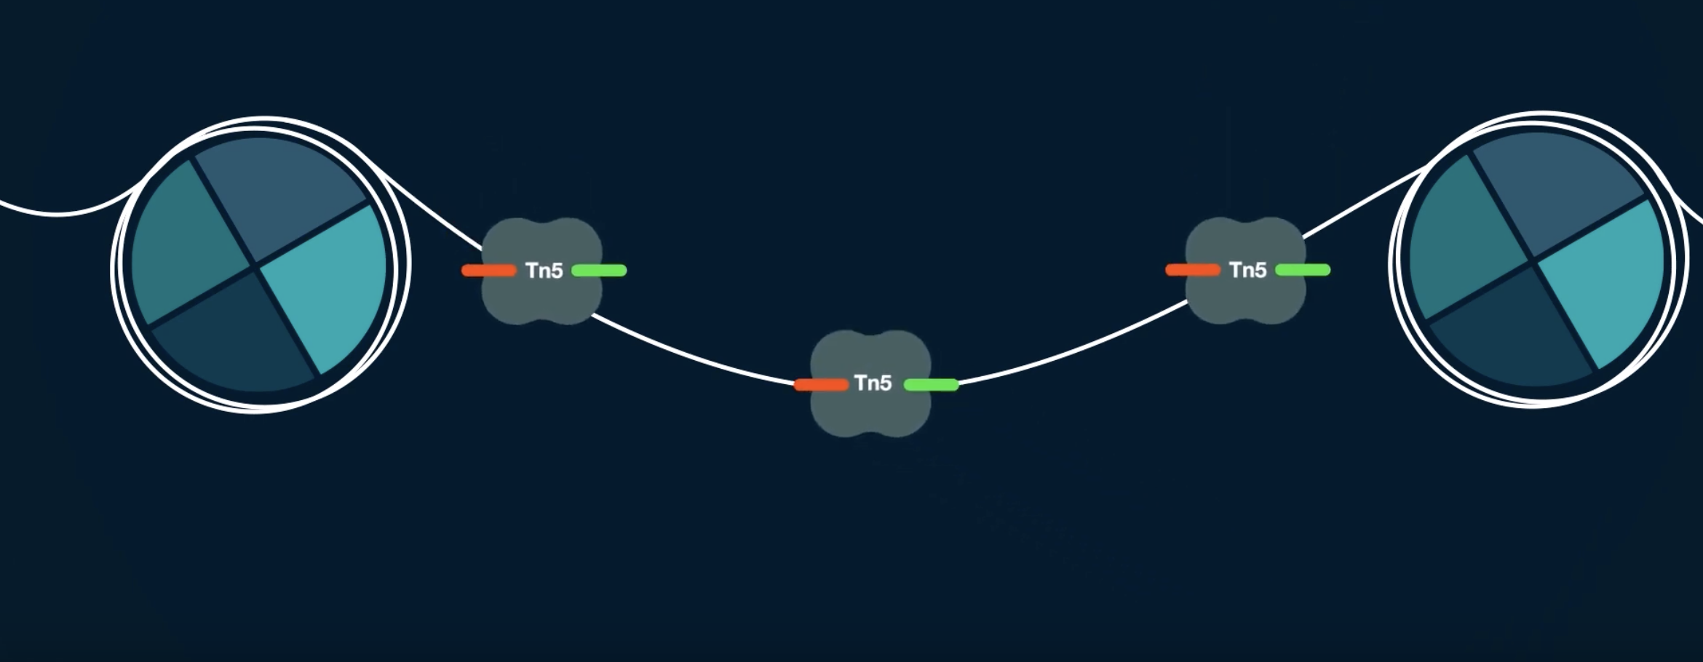
ATAC-Seq detects accessible chromatin regions
ATACseq (as well as scATACseq) measures how open this piece of DNA is. This openness is a proxy of how easily a transcription factor can bind these parts of the genome. ATACseq measures by using an enzyme called Tn5 transposase which binds open chromatin and inserts DNA sequencing adapters.
“How Single-Cell ATAC-Seq Works”, Bio-Rad Laboratories

Slide 5
Chromium Single Cell ATAC-Seq (10x)

Slide 6
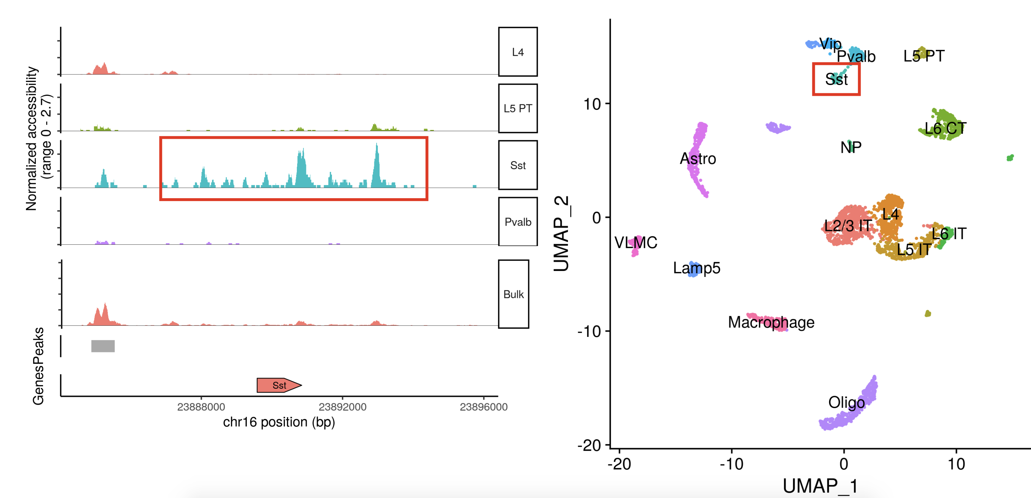
Single cell resolution reveals cell-type specific regulatory elements
Figure adopted from “Analyzing single-cell ATAC-seq datasets” lecture by Tim Stuart

Slide 7
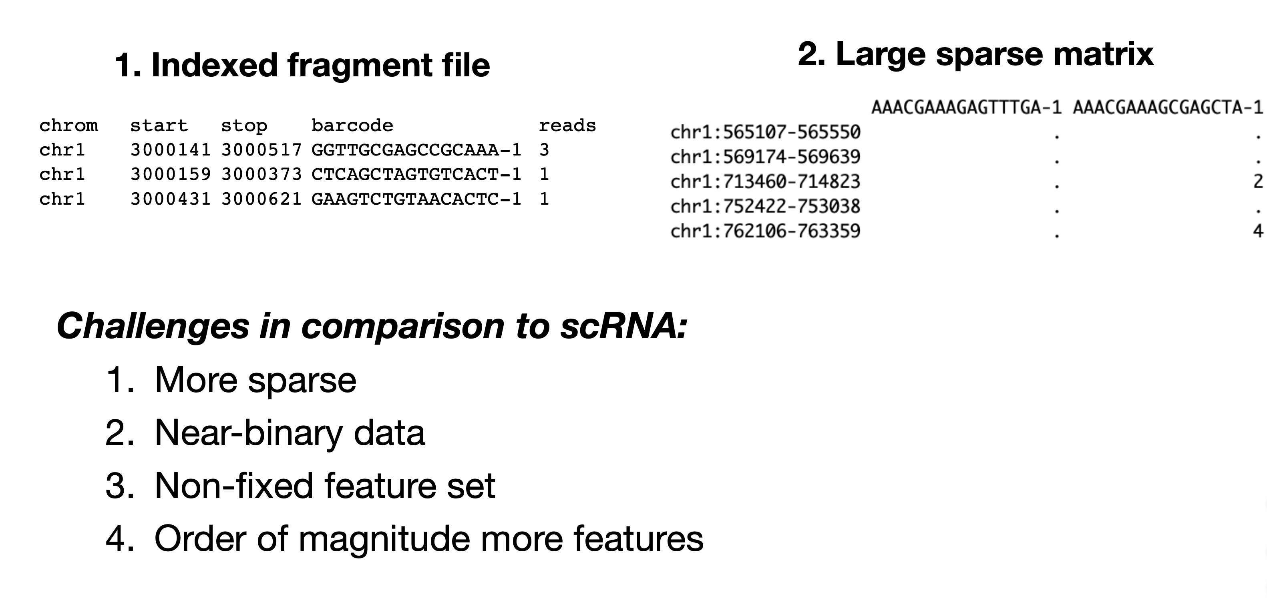
Pre-processing generates a fragment file
and a peak/cell matrix
A full list of all unique fragments across all single cells, as opposed to only reads that map to peaks.
Each value in the matrix represents the number of Tn5 cut sites for each single barcode (i.e. cell) that map within each peak
Figure adopted from “Analyzing single-cell ATAC-seq datasets” lecture by Tim Stuart
Notes:
fragments is used only for gene activity?

Slide 8
scATAC-Seq data is highly sparse
Figure adopted from “Analyzing single-cell ATAC-seq datasets” lecture by Tim Stuart
Notes:
fragments is used only for gene activity?

Slide 9
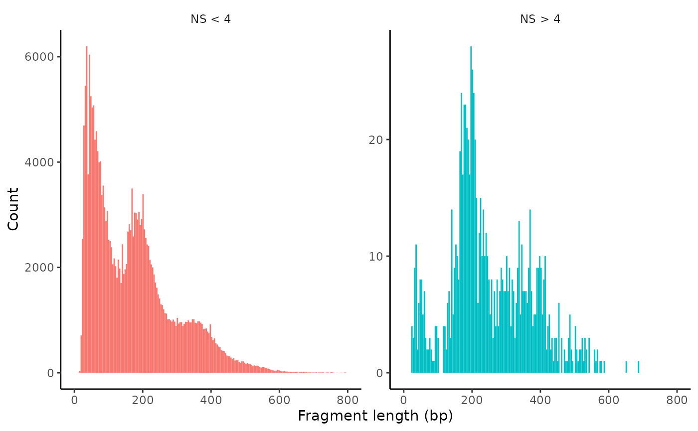
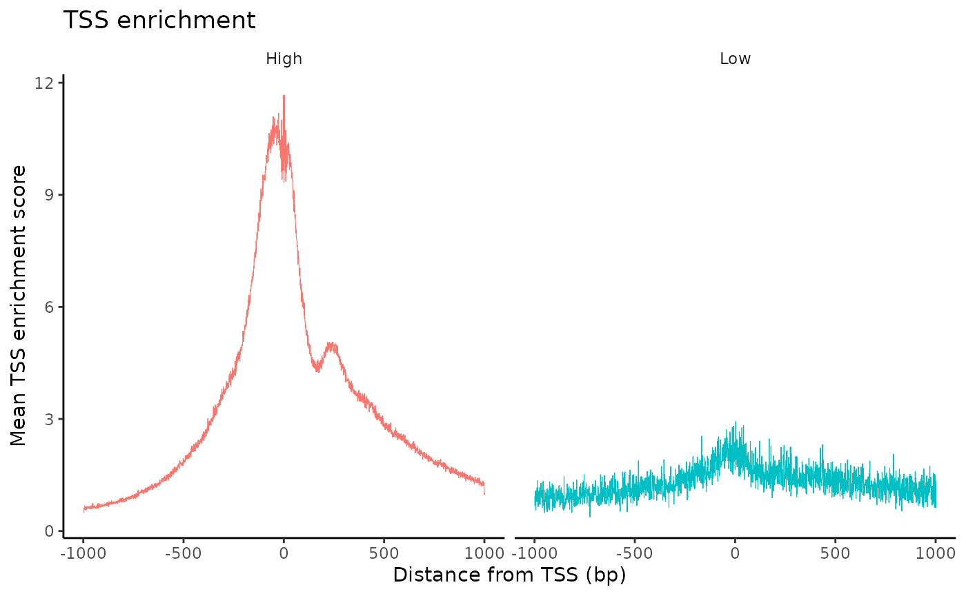
Quality control metrics for scATAC-seq data
Nucleosome banding pattern
Transcriptional start site (TSS) enrichment
Total number of fragments in peaks
Fraction of fragments in peaks

Slide 10
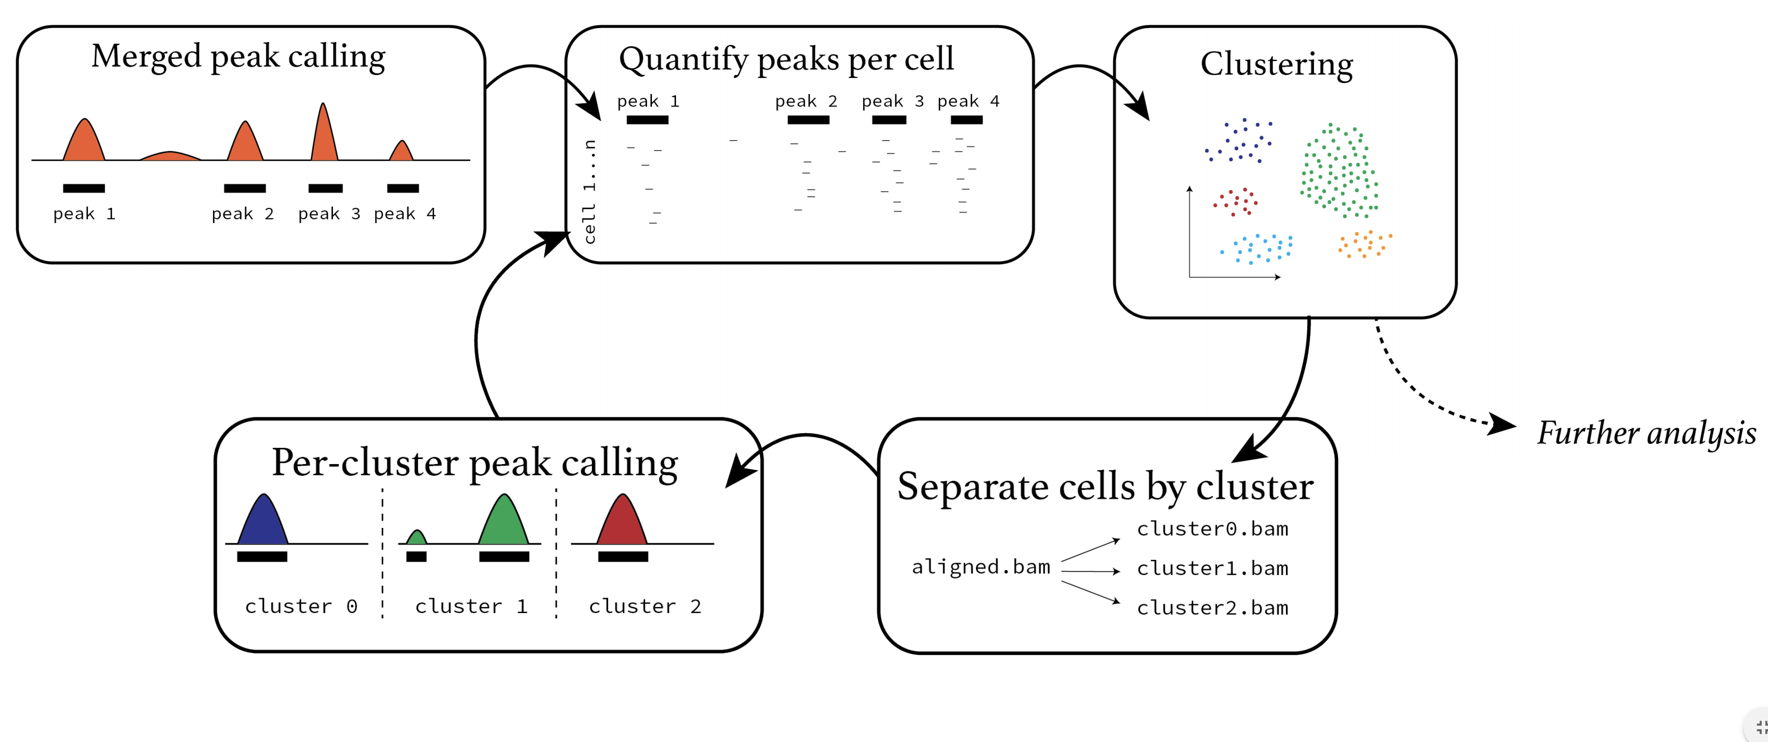
Overview of scATAC-Seq analysis
Figure adopted from “Analyzing single-cell ATAC-seq datasets” lecture by Tim Stuart
Notes:
how do the first peaks defined?

Slide 11
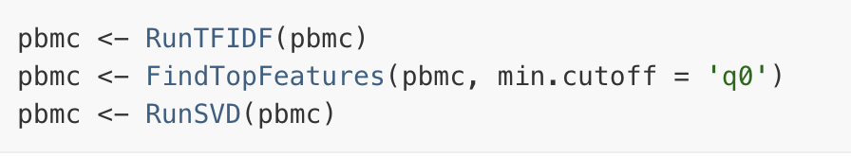
scATAC-Seq often uses latent semantic indexing (LSI) for dimensionality reduction
Originally developed for topic modeling / natural language processing (Deerwester et al. 1990) and first applied to scATAC-Seq in 2015 (Cusanovich et al. Science)
term frequency-inverse document frequency (TF-IDF) normalization followed by singular value decomposition (SVD)
Cell = document and peak = term
Term frequency: normalize across cells to correct for differences in sequencing depth
Inverse document frequency: give higher values to more rare peaks
Figure adopted from “Analyzing single-cell ATAC-seq datasets” lecture by Tim Stuart

Slide 12
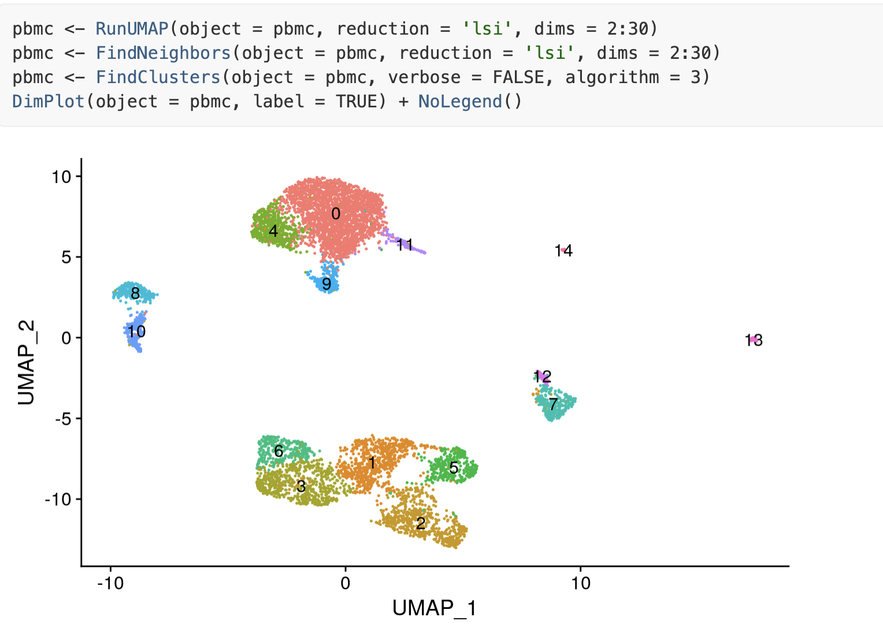
Visualize clusters in scATAC-Seq
Figure adopted from signac tutorial, https://satijalab.org/signac/articles/pbmc_vignette.html

Slide 13
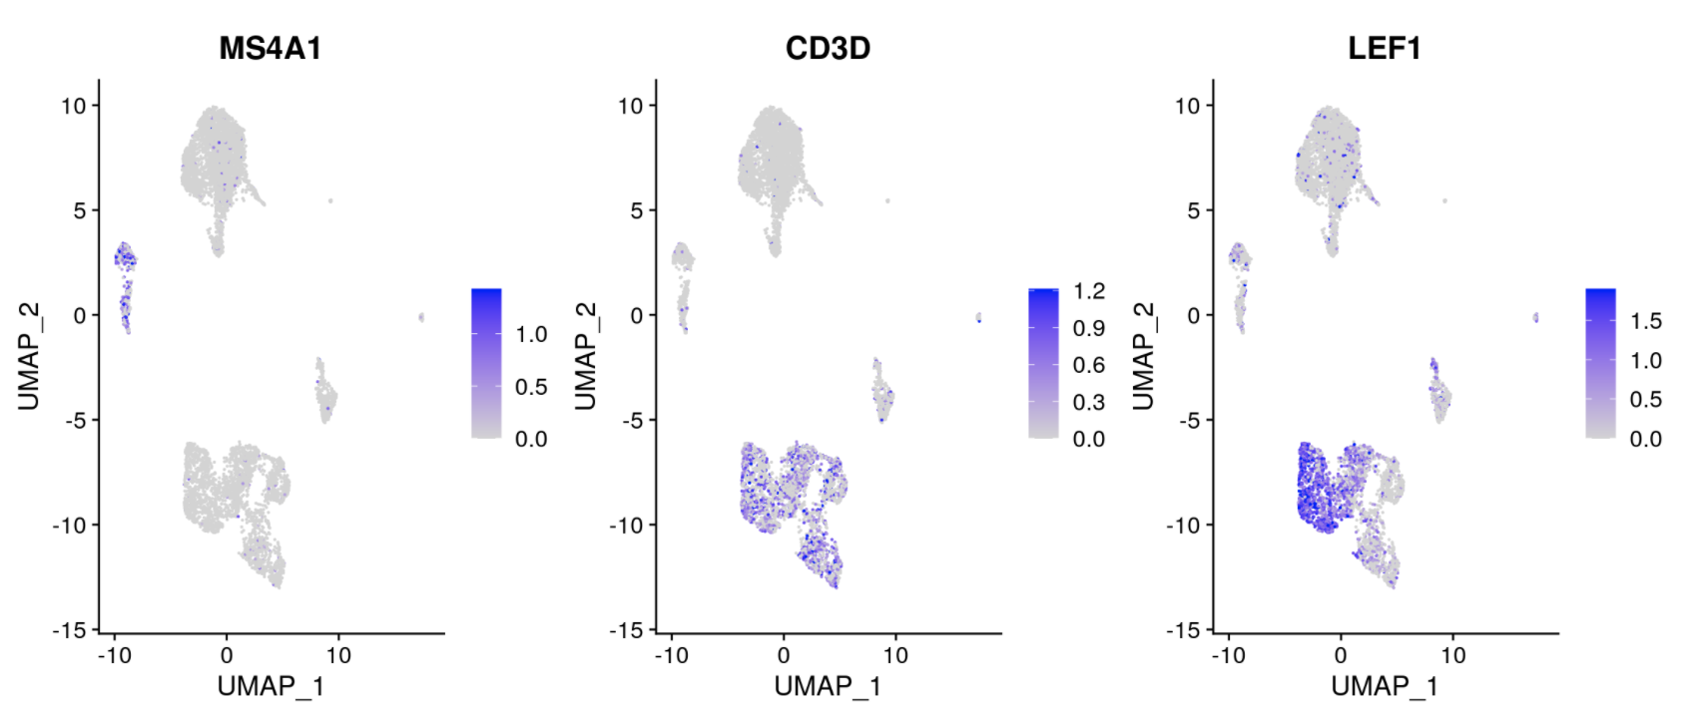
Fragment file helps infer gene “activity” and annotate clusters
Quantify the activity of each gene in the genome by assessing the chromatin accessibility associated with each gene: count the number of fragments for each cell that map to the promoter + gene body
Figure adopted from signac tutorial, https://satijalab.org/signac/articles/pbmc_vignette.html

Slide 14
Integrating with scRNA-seq data using
CCA + MNN (Seurat v4)
Critical assumption: there is generally a positive correlation between chromatin accessibility and gene expression!!!!
Figure adopted from signac tutorial, https://satijalab.org/signac/articles/pbmc_vignette.html

Slide 15
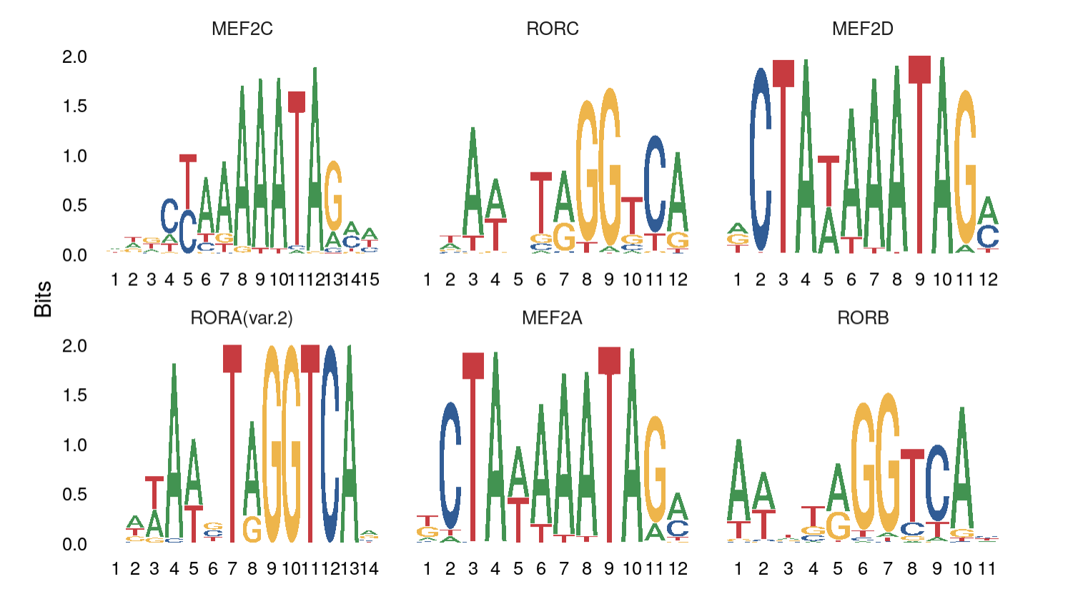
Finding overrepresented motifs
To identify potentially important cell-type-specific regulatory sequences, signac searches for DNA motifs that are overrepresented in a set of peaks that are differentially accessible between cell types.
Figure adopted from signac tutorial, https://satijalab.org/signac/articles/pbmc_vignette.html

Slide 16
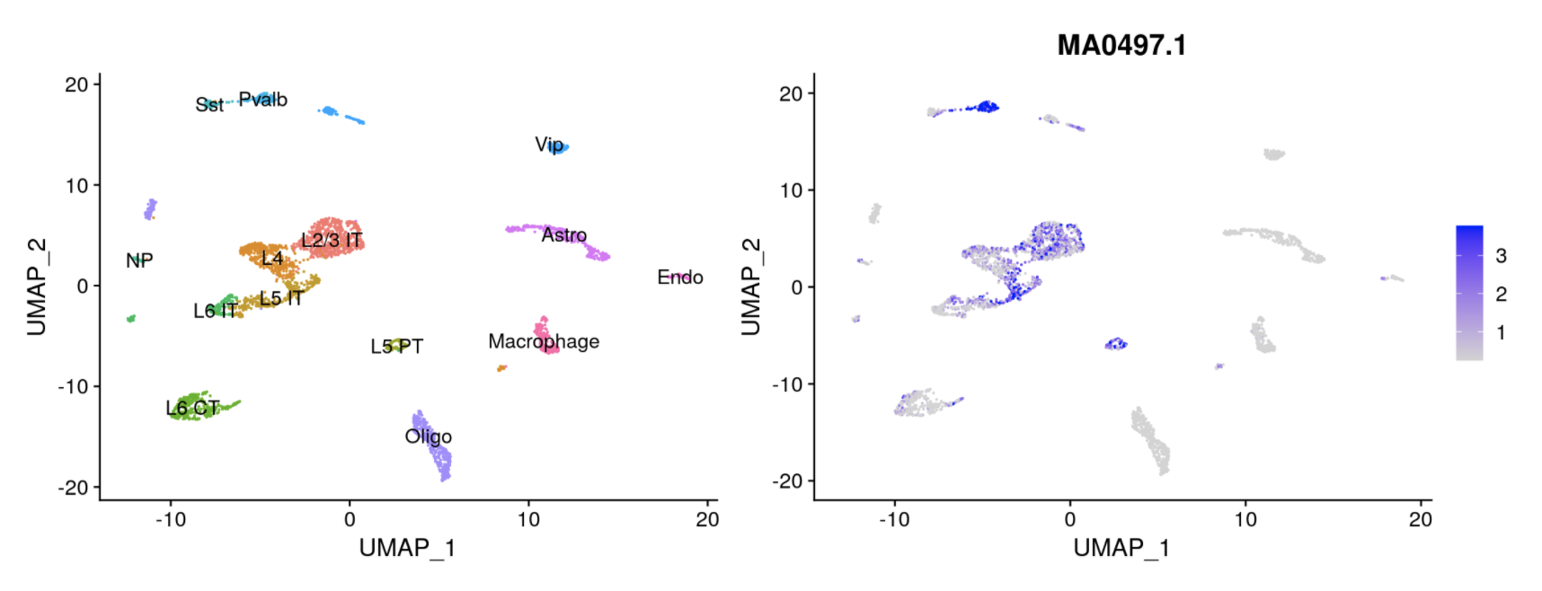
Computing motif activities
ChromVAR identifies motifs associated with variability in chromatin accessibility between cells.
Figure adopted from signac tutorial, https://satijalab.org/signac/articles/pbmc_vignette.html
Notes:
what is the difference

Slide 17
Software for scATAC-Seq analysis
Signac | https://satijalab.org/signac/index.html
SnapATAC | https://github.com/r3fang/SnapATAC
ArchR | https://www.archrproject.com/
cisTopic | https://github.com/aertslab/cisTopic
chromVAR | https://github.com/GreenleafLab/chromVAR
CICERO | https://cole-trapnell-lab.github.io/cicero-release/

Slide 18
Software for scATAC-Seq analysis

Slide 19
Some approaches to multiome data (scRNA-seq and scATAC-seq)
ArchR: https://greenleaflab.github.io/ArchR_2020/Ex-Analyze-Multiome.html
Signac (same people who built Seurat): https://satijalab.org/signac/articles/pbmc_multiomic.html

Slide 20
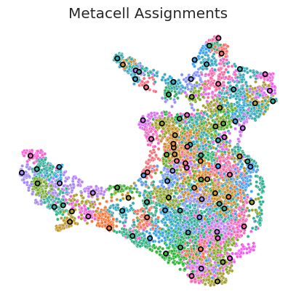
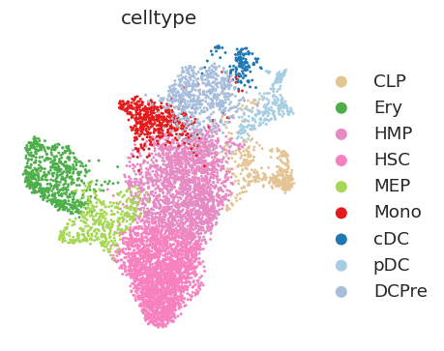
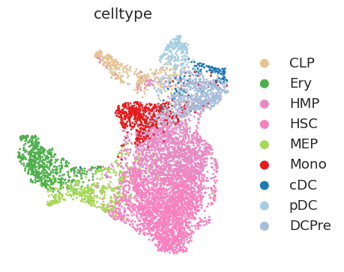
Methods to overcome sparsity in ATAC-seq data
Computing meta-cells is on methodology used to overcome sparsity in scATAC-seq data
Computing meta-cells (e.g. SEACells algorithm) can improve computation of peak-gene associations
scRNA-seq
scATAC-seq

Slide 21
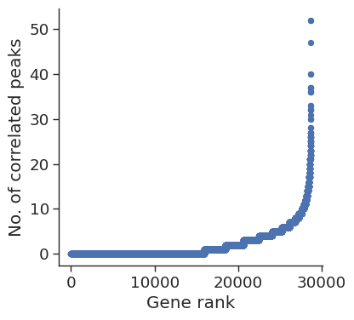
Methods to overcome sparsity in ATAC-seq data
Generate summarized ATAC and RNA metacells
Used the paired multiome metacells to compute the correlation of gene expression and accessibility of peaks within the vicinity of the gene
Pick out highly regulated genes that are correlated with multiple peaks
Calculate gene scores as the weighted sum of the accessibility of correlated peaks
To calculate gene accessibility metrics identify the subset of peaks that are open in each metacell
Open peaks are used to compute a gene accessibility metric which represents the fraction of correlated open peaks

Slide 22
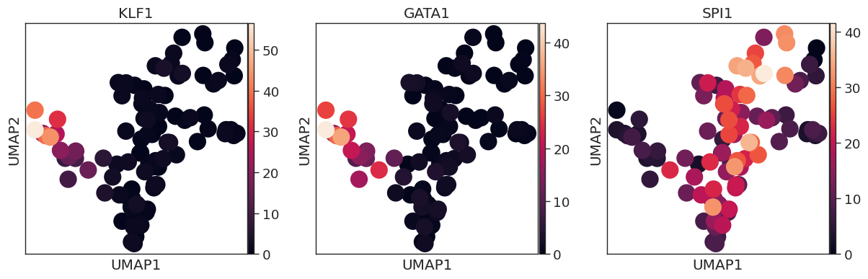
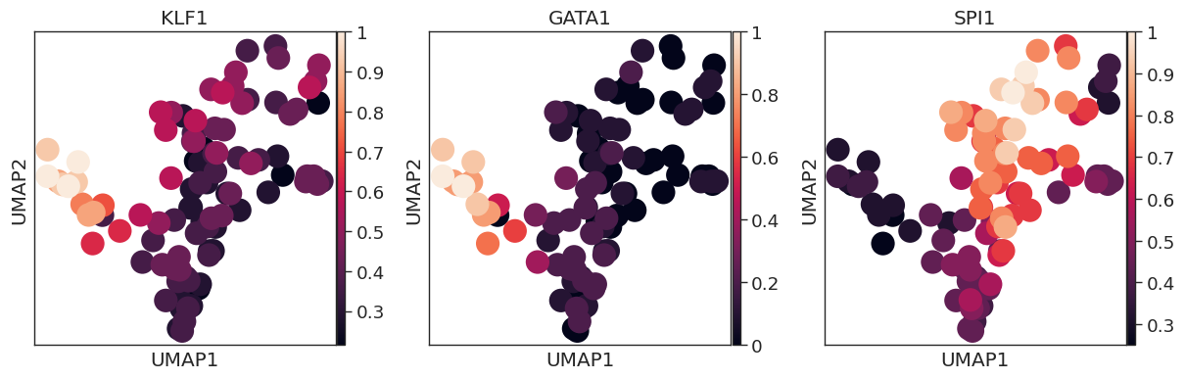
Methods to overcome sparsity in ATAC-seq data
Gene expression
Accessibility

Slide 23
APPENDIX: OTHER MULTIMODAL METHODOLOGIES

Slide 24

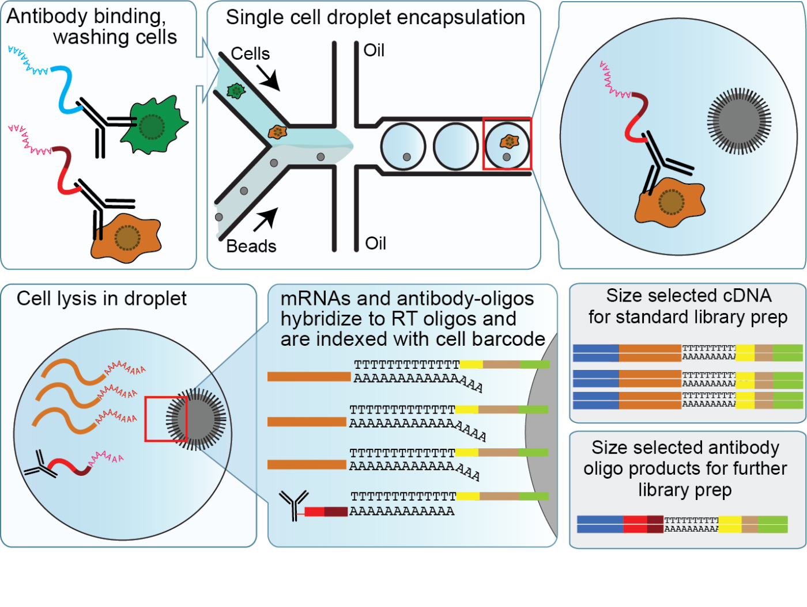
CITE-Seq allows simultaneous measurement of RNA expression and surface protein expression in same cell
Count matrix1: scRNAseq
Count matrix2: CITEseq

Slide 25
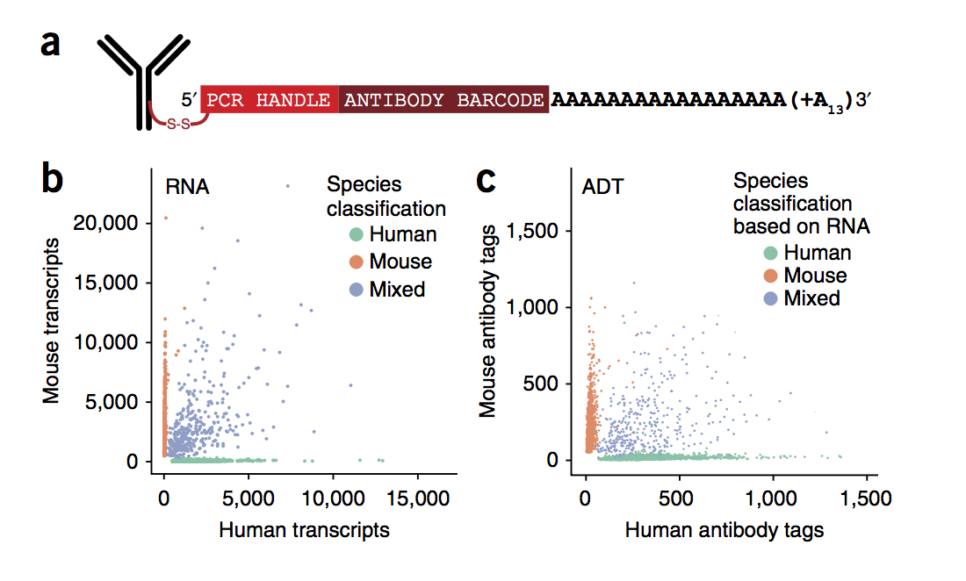
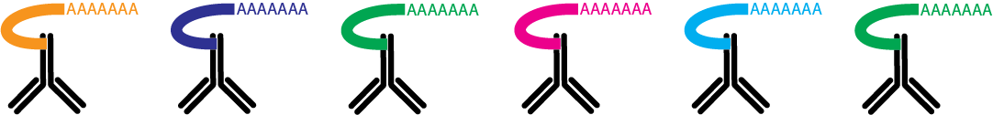
Antibodies are conjugated with DNA-oligos
DNA-oligo indicates antibody identity and contains poly-A tail
CD4
CD14
CD56

Slide 26
Pre-processing generates RNA count
and protein count matrices
scRNA-Seq
CITE-Seq
 | cell1 | cell2 | cell3 | cell4
Gene1 | 0 | 0 | 0 | 4
Gene2 | 0 | 2 | 0 | 0
Gene3 | 0 | 0 | 0 | 0
 | cell1 | cell2 | cell3 | cell4
Antibody for CD4 | 100 | 0 | 0 | 38
Antibody for CD14 | 0 | 0 | 45 | 0
Antibody for CD56 | 2 | 0 | 0 | 0

Slide 27
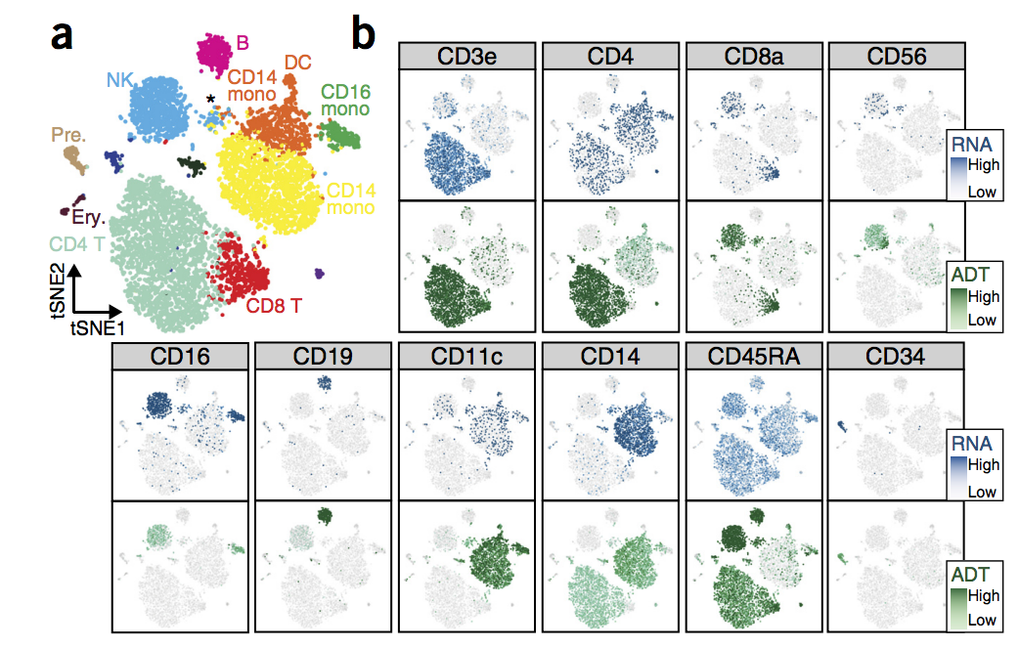
Simultaneous protein and RNA measurement in single cells

Slide 28
Cell hashing using CITE-Seq
Cell Hashing enables sample multiplexing and super-loading on single cell RNA-sequencing platforms.
Cell Hashing uses a series of oligo-tagged antibodies against ubiquitously expressed surface proteins with different barcodes to uniquely label cells from distinct samples, which can be subsequently pooled in one scRNA-seq run.
B2M
B2M
B2M
B2M
B2M

Slide 29
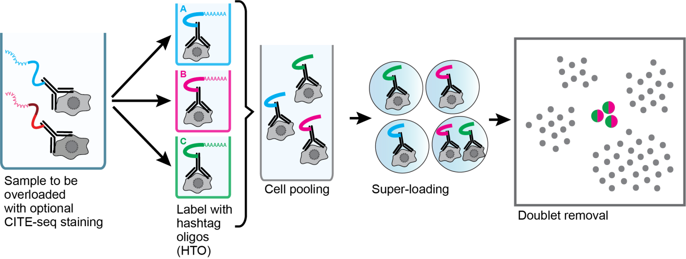
With cell hashing, we can “overload” the 10x channel
By sequencing these tags alongside the cellular transcriptome, we can assign each cell to its sample of origin, and robustly identify doublets originating from multiple samples.

Slide 30
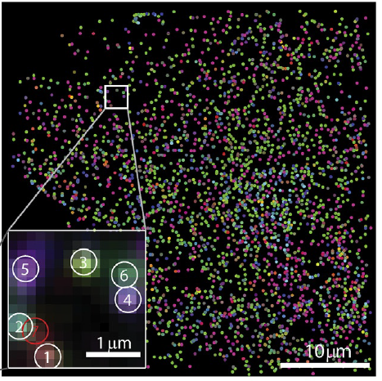
Ongoing developments in single-cell genomics:
Growing toolbox for spatial genomics
MERFISH (RNA)
CODEX (protein)
mouse spleen
High Density Spatial Transcriptomics (RNA)
breast cancer
Moffitt J.R. et al. (2016) PNAS 113: 11046-11051.
Goltsev Y. et al. (2018) Cell. 174: 968-981.
Vickovic S. et al. (2019) Nature Methods. 16: 987–990.
Notes:
One of most exciting developments is being able to characterize single cells while maintaining information on their spatial context, ie neighbors. What is neighborhood of cell and how does each cell influence its neighbors (presence/absence, signaling).

Slide 31
Ongoing developments in single-cell genomics:
Growing toolbox for spatial genomics
MERFISH (RNA)
High Density Spatial Transcriptomics (RNA)
CODEX (protein)
Major method differences
detecting RNA or protein
choosing target genes/proteins or full transcriptome
number of cells profiled
single-cell or almost single-cell resolution
in situ vs traditional sequencing
…
Notes:
One of most exciting developments is being able to characterize single cells while maintaining information on their spatial context, ie neighbors. What is neighborhood of cell and how does each cell influence its neighbors (presence/absence, signaling).

Slide 32
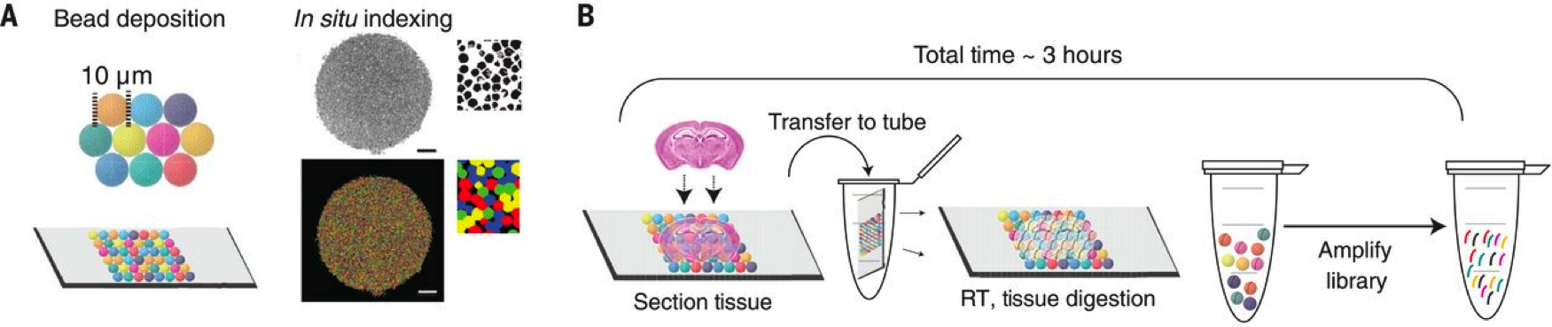
Slide-Seq overview (full transcriptome)
Rodrique, S. et al., Science (2019).
Stickels, R. et al., Nature Biotechnology (2020).
Notes:
To develop our Slide-seq technology for high-resolution genome-wide expression analysis, we first packed uniquely DNA-barcoded 10-μm microparticles (“beads”)—similar to those used in the Drop-seq approach for single-cell RNA sequencing (scRNA-seq) (5)—onto a rubber-coated glass coverslip to form a monolayer we termed a “puck” (fig. S1). We found that each bead’s distinct barcode sequence could be determined via SOLiD (sequencing by oligonucleotide ligation and detection) chemistry (Fig. 1A and fig. S1) (6–8). We next developed a protocol wherein 10-μm fresh-frozen tissue sections were transferred onto the dried bead surface via cryosectioning (7). mRNA released from the tissue was captured onto the beads for preparation of 3′-end, barcoded RNA-seq libraries (5) (Fig. 1B). Clustering of individual bead profiles from a coronal section of mouse hippocampus (7) yielded assignments reflecting known positions of cell types in the tissue

Slide 33
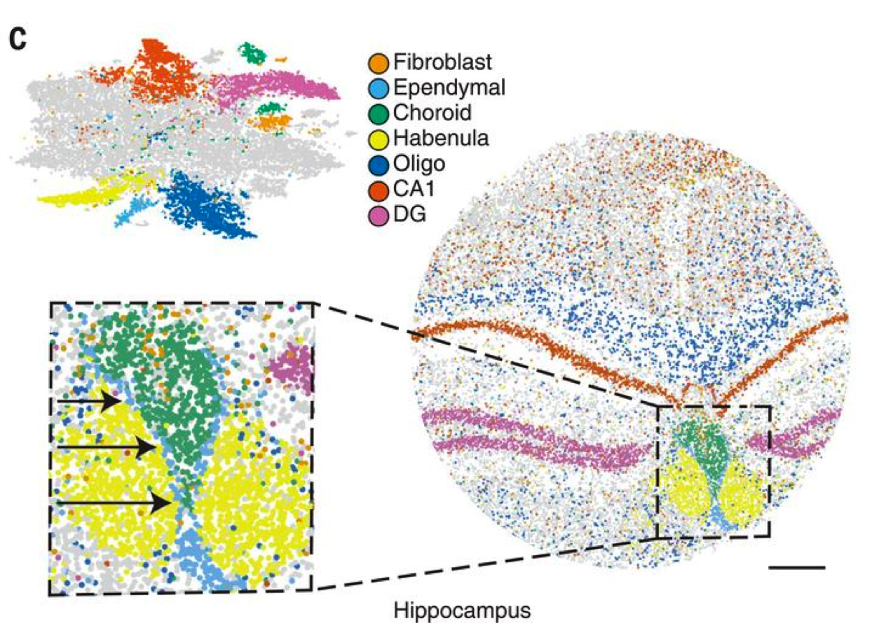
Slide-Seq overview
Slide-Seq is close to single-cell resolution (10 μm bead) but usually requires deconvolution of the beads to identify the contributing single cells.
Visium (10x) is a related spatial transcriptomic technology.
Rodrique, S. et al., Science (2019).
Stickels, R. et al., Nature Biotechnology (2020).

Slide 34
MERFISH overview (choose target genes)
“multiplexed error-robust fluorescence in situ hybridization (MERFISH), a massively parallelized form of smFISH that can image and identify hundreds to thousands of different RNA species simultaneously with high accuracy in individual cells in their native spatial context.”
Moffitt, J. R. and Zhuang, X. Methods in Enzymology (2016).

Slide 35
MERFISH overview
Imaging 100s-1000s RNA species in their native cellular and tissue environment
Moffitt, J. R. and Zhuang, X. Methods in Enzymology (2016).

Slide 36
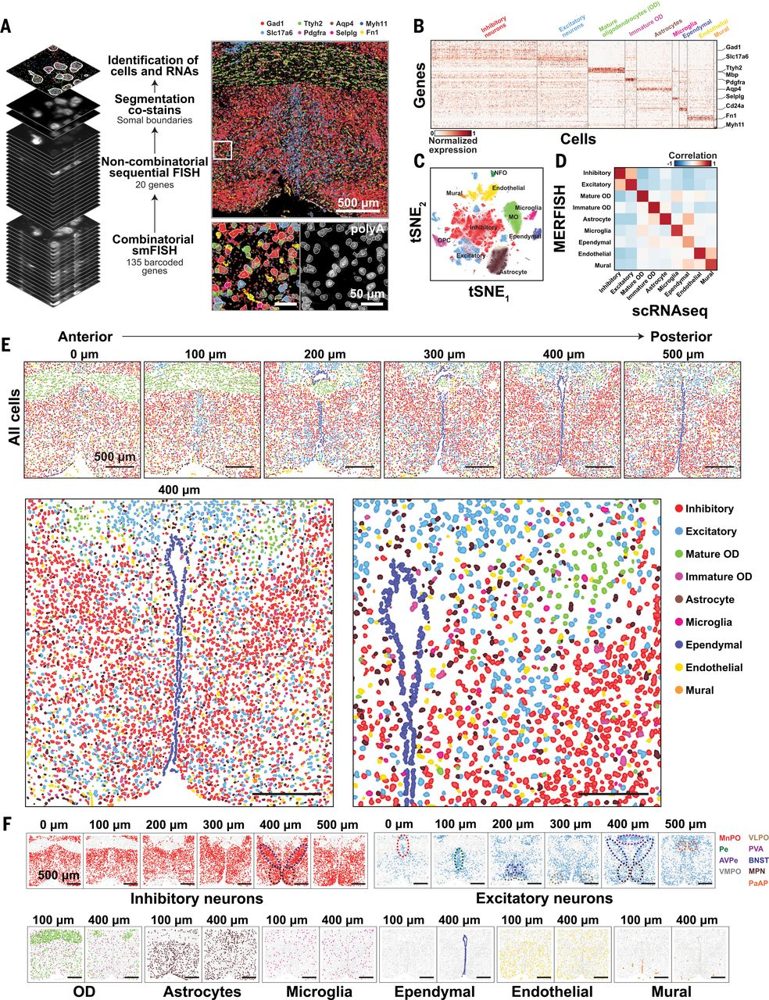
MERFISH overview
Moffitt, J. R. et al., Science (2018).

Slide 37
MERFISH overview
Moffitt, J. R. et al., Science (2018).

Slide 38
CODEX overview (choose target proteins)
Stain and iteratively image antibodies applied to a tissue sample
Schürch, C. M. et al., Cell (2020).

Slide 39
CODEX overview: 56 antibody marker panel
The antibody panel must be validated, and the panel typically includes many immune targets
Schürch, C. M. et al., Cell (2020).

Slide 40
CODEX overview: multi-tumor tissue microarray
Schürch, C. M. et al., Cell (2020).

Slide 41
CODEX overview: multi-tumor tissue microarray
Schürch, C. M. et al., Cell (2020).

Slide 42
CODEX overview: 56 antibody marker panel
Big challenges
Imaging
Segmentation
Analysis

Slide 43
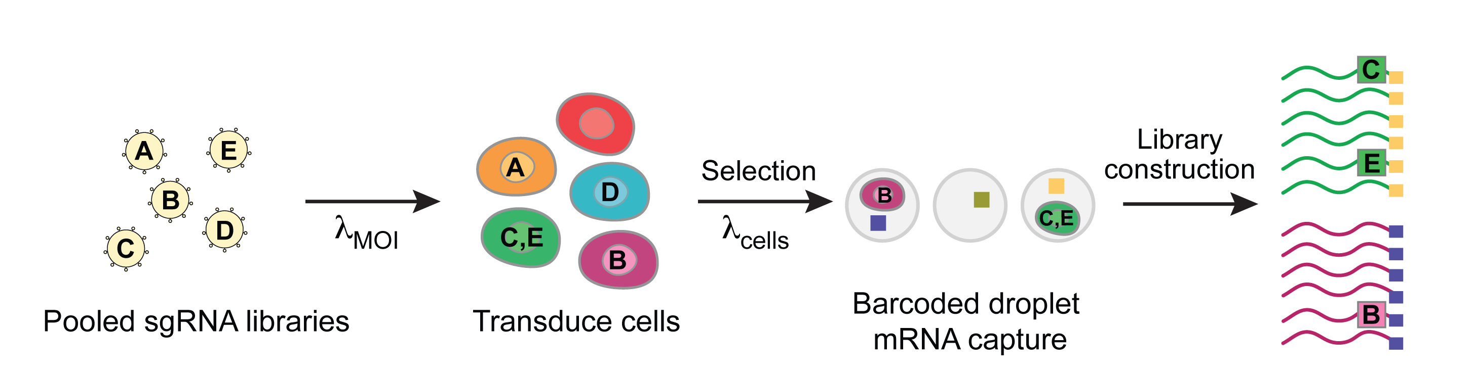
Perturb-Seq overview
I. Pooled sgRNA library,
polydenylated guide barcode
II. Transduce cells (low or high MOI)
III. Capture cells, barcode mRNA
IV. Match guide barcode to transcriptome
Perturb-Seq advantages
no need to define a phenotype beforehand
single cell readout
pooled format
higher order interactions
Dixit*, Parnas* et al., Cell 2016; Adamson*, Norman* et al., Cell 2016

Slide 44
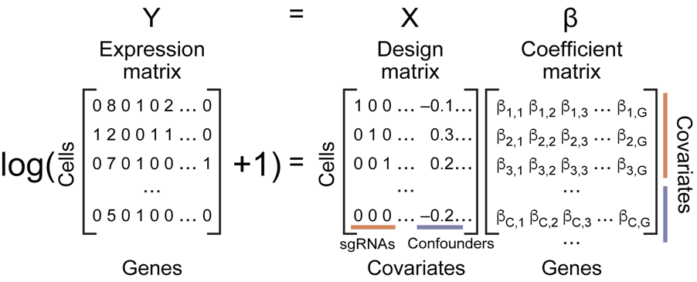
Perturb-Seq overview
Perturb-Seq links perturbations to their effects on the transcriptome
Transduce cells
with sgRNA library
Capture cells, barcode mRNA
Match guide barcode to transcriptome
Infer perturbation regulatory effects
Dixit, et al. Cell (2016).
Notes:
We then validate these regulators using CRISPR genetic screens, in work led by Cores C and D. I want to highlight Perturb-Seq, which is a single cell assay linking the gene perturbation to its effect on the entire transcriptome.
Transduce cells with barcoded sgRNA library, carry out some selection, isolate single cells and barcode mRNA, and match guide barcode to transcriptome
Using the gene expression within each cell along with what perturbation the cell received, we can then build linear models to infer how each perturbation affects the expression of each gene, and determine how the perturbation affects the immune cell’s overall state.
Perturb-Seq tells us much more about gene’s function, see how perturbation affects gene modules. Perturbations reveal gene regulation logic
Traditional screen disadvantages, perturbation only links to a single, pre-defined phenotype (need to know phenotype ahead of time and only 1 protein/1 gene)
Guides and genes cluster into transcription factor modules (M) and regulated expression programs (P) respectively (show previous slide)

Slide 45
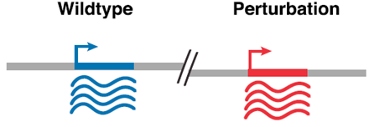
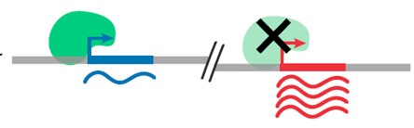
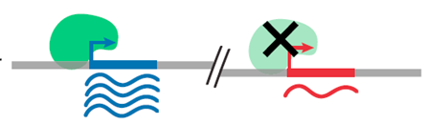
Ongoing developments in single-cell genomics:
Perturb-Seq
β is the regulatory effect a given guide has on a given gene.
Expression
(observed)
GBCs
(observed)
Regulation
(fit)
Wildtype Perturbation
Unbound
β = 0, no change
Inhibitor
β > 0, increased expression
Activator
β < 0, decreased expression

Slide 46
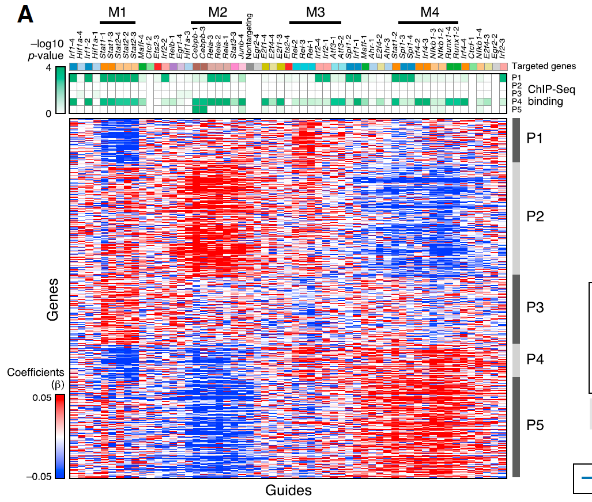
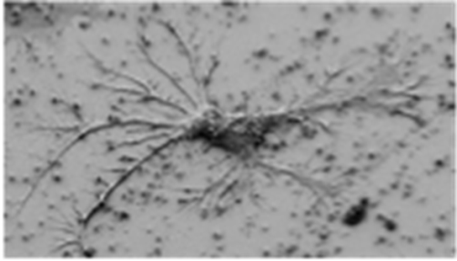
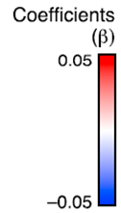
Perturbations reveal gene regulation logic
Guides and genes cluster into transcription factor modules (M) and regulated expression programs (P) respectively.
Bone-marrow derived dendritic cells are stimulated with LPS.
24 TFs are targeted.
Genes
Coefficients
(β)
Inhibitory
Activating
Guides

Slide 47
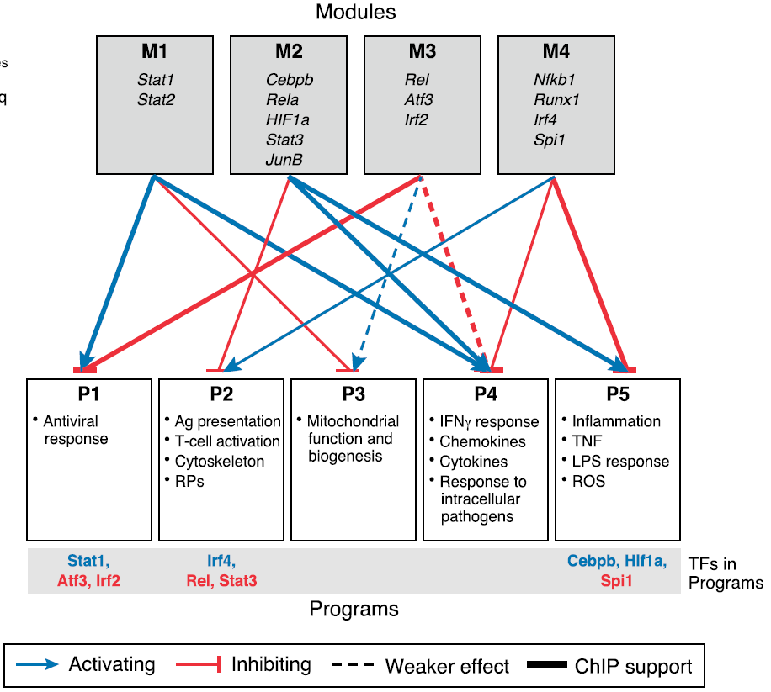
Perturbations reveal gene regulation logic
Modules
Module activates program
Module represses program
Programs

